Slide 1
Precise Measurement of Dolomite
Content and its link to dissolved
Magnesium in Marine Sediments
Written by Pazi Shacham, Earth Science Project course – 20575 at the Open University
Guidance : Eyal Wurgaft,(PhD ,Lecturer the Avinoam Adam Dept. of Natural Sciences the Open University of Israel)
Tuesday, January 4, 2022

Slide 2
ABSTRACT
Recent studies, regarding the oceanic Mg cycle and budget value over the last 20 million years, concluded that dolomite is continuously created in the deep-sea sediments. This process
doesn’t need evaporitic conditions and certain threshold Mg/Ca ratio. However, no direct measurements of a dolomite content in marine sediments was shown to support or reject this argument. These missing measurements are the issue of this study, showing Mg decrease from 59 mM @ depth = 33 cm (below sea floor) to 53 mM @ 128 cm, in parallel to dolomite increasing from 0.7 to 1.1 wt% in this range.

Slide 3
Introduction
Oceanic magnesium concentration values are important since they are tightly related to various aspects of the oceanic system, for example its carbon cycle.
Recent studies indicated that an oceanic Mg balanced values require a significant dolomite creation, in contrast with different assessments published in previous studies. The studies based their arguments on analyses of Mg concentration and its stable $δ^{26}Mg$ isotopic composition.
$δ^{26}Mg$ expresses the ratio between Mg heavy isotope ²⁶Mg to its ²⁴Mg regular and defined as:
$δ^{26}Mg$ = [(²⁶Mg/²⁴Mg)sample / [(²⁶Mg/²⁴Mg)standard -1] x 1000 (in ‰)

Slide 4
Introduction - continue
Pore-fluid isotope ratios, mainly ²⁶Mg / ²⁴Mg, are used to as a tool to explore the magnesium gradients in deep sea water. Works done before
the above-mentioned studies indicated that this ratio is depleted in carbonate sediments but enriched in silicate minerals (Galy et al., 2002; Young and Galy, 2004; Tipper et al., 2006b), though there are still uncertainties (Pogge von Strandmann et al., 2008).
According Gally et. al (2002) and Carder et. al (2005), fractionation factors of magnesium, $ε_{s−f}^{26/24}$, for precipitation of speleothem calcite and dolomite are in the range -2.7‰ to -1.4 ‰ where $ε_{s−f}^{26/24}$ = 1000 * ( $α_{s−f}^{26/24}$ – 1) and $α_{s−f}^{26/24}$ = (²⁶Mg/²⁴Mg)s *(²⁶Mg/²⁴Mg)f and s-f means sediment compared to fluid.

Slide 5
Introduction - continue
This negative factor indicates a ²⁶Mg depletion in carbonate minerals. In contrast, a preference of this isotope was estimated in silicate minerals from measured soils samples and shales, which found enriched in ²⁶Mg/²⁴Mg ( $ε_{s−f}^{26/24}$ ~ 0.3 to 0.5‰) (Tipper et al., 2006a; Teng et al., 2007).

Slide 6
Introduction continue: Higgins and Schrag 2010 study
This study presents the elemental and isotopic composition of pore-fluids, belong to samples extensively sampled from DSDP and ODP sites.
The study shows that Mg concentrations vs depths trend is similar to profiles associated with Mg isotopic profiles. The Mg isotope fractionation factors are estimated by deep-sea sediment diffusion-reaction model. In parallel, $δ^{26}Mg$ values have been independently measured at sites include dolomite beds.
The general trend of Mg concentration, a decrease with depth is seen at all tested sites, though the profiles are different in shape rate and values.

Slide 7
Higgins and Schrag 2010 study - continue
The measured Mg concentrations indicate a precipitation of Mg in carbonate minerals, e.g., dolomite and for Mg with clays reactions, either in the sediment column (carbonate) or in the underlying basaltic crust (clays reactions (Lawrence et al., 1975; Gieskes and Lawence, 1981; Baker, 1985; Moore et al., 2004).
Based on measurements and a numerical model the study shows a systematic trend with depths in measured $δ^{26}Mg$ profiles and $δ^{26}Mg$ profiles. At sites 1012, 1082 and 1086, $δ^{26}Mg$ values increase with depth by values in the range 1.25-2‰. In contrast, at sites 925, 1219 and 984 the pore-fluid $δ^{26}Mg$ values decrease with depth.
The increase at sites 1082, 1086 and 1012 is explained by dolomite precipitation that is depleted in $δ^{26}Mg$ relative to pore-fluid by -2.0‰ to – 2.7‰

Slide 8
Higgins and Schrag 2010 study - continue
The decrease in $δ^{26}Mg$ values vs depth at sites 1219, 925 and 984 can be interpreted as attributed to Mg-clay minerals precipitation that are enriched in $δ^{26}Mg$ relative to the pore-fluid ($δ^{26}Mg$ “prefers” the crust clay minerals so less amount remains in the pore-fluid).
In summary, Higgins and Schrag 2010 study findings clearly point on Mg behavior which leaded to dolomite creation in deep-sea sediments. Knowing this, the next step to do is to make this conclusion quantitative by measurement of dolomite content in samples.

Slide 9
Introduction continue: Shalev et.al 2019 study
This study is also using widely Mg isotope data and fractionation factors calculations but reaches to conclusions based on exploration of the ocean Mg budget balance, e.g., sources vs sinks. In addition to the carbonate minerals precipitation, this study considering first time the influence of Low Temperature Hydrothermal (LTH) flow system on the oceanic Mg precipitation, since the High Temperature Hydrothermal(HTH) is well constrained.

Slide 10
Introduction continue: Shalev et.al 2019 study
Mg removal is temperature dependent, and the range of influence is 20-65°C. The input Mg flux amount to the seawater is known quantitively and so the amount of flux removed by the HTH system (Berner and Berner , 1996; Elderfield, H. & Schultz, 1996; Holland, 2005; Vance, D., Teagle, D. A. H. & Foster, G. L., 2009). In contrast, estimation of Mg flux into LTH systems was unknown and the study estimates it first time. The next slide presents schematically the hydrothermal systems and show Mg concentration change vs Sediment Basement Interface (SBI) temperature in LTH fluids (data is from Wheat et.al, 2017,2003,2004,2013 , Fisher et. al, 2012 and Fisher and Wheat, 2012). The blue dashed line shows the seawater (sw) concentration level (53 mmol/kg). The gray-solid line (H&S) is a modeled temperature dependence taken from Higgins and Schrag, 2010) (picture taken from Shalev et al., 2019)

Slide 11
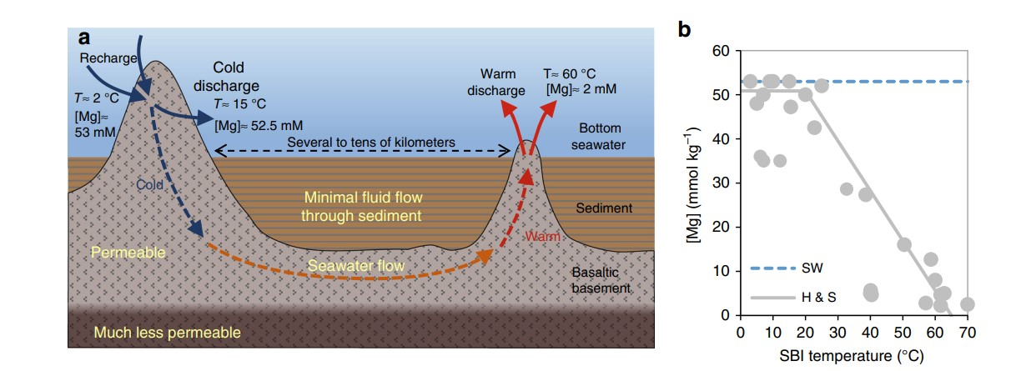

Slide 12
Shalev et.al 2019 study - continue
The study explores the values of $δ^{26}Mg$ and related fractionation factors. The isotope fractionation that seen upon Mg removal from LTH water flux and sinks in the solid crust, defined as: $ε_{solid−fluid}$ =
${(∝}_{solid−fluid}$ – 1) * 1000 where $∝_{solid−fluid}$ = (²⁶Mg/²⁴Mg)solid / ²⁶Mg/²⁴Mg)fluid . Similarly, the terms $ε_{dol−sw}$ , $ε_{LTH−sw}$ are the isotope enrichment factors during dolomite formation and LTH alteration respectively, reflect the $δ^{26}Mg$ values of dolomite and LTH water flux relative to seawater.
The $δ^{26}Mg$ value of modern seawater is -0.83‰ (Foster, G. L., Pogge Von Strandmann, P. A. E. & Rae, J. W. B. , 2010; Ling, M. X. et al.,2011 ).

Slide 13
Shalev et.al 2019 study - continue
The study presents $δ^{26}Mg$ values in LTH fluids by measurement of samples under a wide range of SBI temperatures (6 – 64°C) and in accordance, Mg concentrations (1.3 – 52.5 mmol/kg) from sites sampled. One of the study findings is that the Mg heavy isotope removal is temperature dependent.
The Mg isotope $δ^{26}Mg$ values have been measured as a function of $f_{Mg}$ ,the remaining fraction of Mg concentration relative to bottom seawater (as shown in Higgins and Schrag study above, this concentration decreases with depth).

Slide 14
Shalev et.al 2019 study - continue
The measured values of all samples are lower than -0.83‰ , indicating preferential Mg removal of the heavy isotope into the oceanic crust. The LTH isotope fractionation $ε_{solid−fluid}$ e.g., crust relative to LTH water flux factors are positive in the range 0.25 – 7‰. In contrast, the opposite direction reflects fractionation factor of dolomite formation, e.g., negative values of $ε_{dol−sw}$, pointing again on dolomite depletion in ²⁶Mg. The familiar phenomenon of $δ^{26}Mg$ depletion with Mg concentrations decrease along depths is also seen in this study results (as in Higgins and Schrag(2015)) but here it also depends on SBI temperatures: the depletion is reduced while temperature decreases.

Slide 15
Shalev et.al 2019 study - continue
Indeed, the study proves that the average SBI temperature must be less than 20°C. Under average temperature of 15°C, calculations of $ε_{LTH−sw}$ , the value of the fractionation factor of LTH flux relative seawater (considering the temperature dependence) is in the range 0.6 - 7‰. This is in line with the range of $ε_{solid−fluid}$ demonstrating the LTH systems effect on Mg sink.
Based on the above results and additional calculations, the study shows that the resulting dolomite flux $F_{dol}$ in the sediments is in the range of 1.5-2.9 Tmol /yr. These values are higher than suggested in previous studies: 1.7 by Holland, 2005; 0.75-1.0 by Higgins, J. A. & Schrag 2015; 0.75-1.75 by Gothmann et.al.,2017. The study also shows that it is impossible to keep the value of the $δ^{26}Mg$ values of the ocean close to constant without magnesium sink creating a significant dolomite amount.

Slide 16
Shalev et.al 2019 study summary
In summary, this study shows the important role of LTH systems related to the oceanic Mg budget. It is an additional parameter in the Mg budget calculation, which was not taken into account so far, and it changes significantly the dolomite content value, created in deep-sea sediments.
Since both the above studies point on a significant amount of deep-sea dolomite precipitation, the next stage is to measure dolomite content in samples from different locations.

Slide 17
Methods
So far, several methods have been used to measure the dolomite content in sediments samples. However, those were found not precise enough. The very high required precision stems from the small abundance of dolomite in marine sediments in comparison to that of more – soluble carbonate minerals as calcite and aragonite. Very often, these minerals co-exist.
Estimation of the dolomite content in marine sediments done by Eyal Wurgaft,(PhD ,Lecturer the Avinoam Adam Dept. of Natural Sciences the Open University of Israel) in his research proposal regarding this subject (August 2019) show that the measurement test system should detect values of about 0.2 % dry wt dolomite, e.g., accuracy of ± 0.1%.

Slide 18
Methods - continue
So far, a few methods for dolomite content measurement in sediment samples have been used, with inadequate precision. Unfortunately, all of these don’t have enough accuracy:
* Method based on X-ray diffraction (XRD) (Hillier, 2000; Royse et al., 1971). – accuracy of ± 3%
* dissolution of the bulk sediment in sample and then measure the amount of dissolved Ca and Mg in the solution. Its wrong assumption that the only source for Mg in the sample is dolomite , while calcite and aragonite (and additional minerals) exist too, leads to a big error in the measured result.

Slide 19
Methods - continue
* Gasometrical detection, based on dissolution rate of carbonate minerals, which is significantly different for dolomite and other minerals as calcite and aragonite. This method is based on ${CO}_{2}$ pressure variations detect associated with the gas release as dolomite is dissolved in acid in much slower rate than other minerals. The detection limit is about ~5% dry wt and precision of ± 1 % dry wt (Hetenyi and Varsanyi, 1975; Skinner et al., 1959) these limits constrain this method usage to samples containing large fraction of carbonate minerals including a big amount of dolomite. In addition, the method cannot differentiate between dolomite and other low-solubility rate minerals as siderite (${FeCO}_{3}$), rhodochrosite (${MnCO}_{3}$) and magnesite (${MgCO}_{3}$).

Slide 20
Method used this study
In this study, a new gasometrical method is used. The working principles are based on the amount of ${CO}_{2}$ released during a sequential acid-dissolution of carbonate minerals due their different rates, dissolved at different temperatures. These released ${CO}_{2}$amounts can represent quantitively each mineral. The flowing ${CO}_{2}$ is moving through an IR waves source and detection facility (by K-30 ${CO}_{2}$ sensor). A specific IR wave lengths are absorbed, and the detector can identify these wave lengths and to measure their energy, which translated into the mole fraction of the ${CO}_{2}$ (x${CO}_{2}$) The IR detector achieves a high signal-to-noise ratio, better than 0.05%, yielding a high precision and accuracy and robust measurements. The next slide demonstrates the test system block diagram.

Slide 21
Test Measurement set up: Gasometrical System Block Diagram

Slide 22
Test Procedure
A grounded, sieved weighted sample located at the reaction vessel.
System x${CO}_{2}$ zero level: by a carrier $N_{2}$ gas (99.999%) flashes. First,
the vessel is in 0 c°, a 10% Phosphoric Acid ($H_{3}{PO}_{4}$) is added to the sediment and the stirrer is operated. Soluble minerals as calcite, aragonite dissolve rapidly (Al-Asam et al., 1990). The ${CO}_{2}$ peak seen belongs to these minerals. Once a minimum level arrives, the temperature is raised to 60c° . Now the dolomite is dissolved and the area under the peak shown on the computer screen represents the dolomite amount in the sample. The integration result is inserted to the calibration curve (a strait line) to get the dolomite content in the sample in wt %.

Slide 23
Test Procedure - continue
The management software controlled the system was written in MATLAB. A few different modules are used for control, calibration, and area calculation under the form calculation. The Next slide shows qualitatively the peak forms seen during the stages of minerals dissolution as described before.

Slide 24
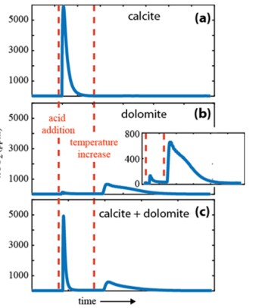
The x${CO}_{2}$ IR spectrum peaks created from minerals dissolution

Slide 25
x${CO}_{2}$ IR spectrum peaks
Part c in the previous slide shows the practical case of both calcite / aragonite and dolomite minerals peak (there are additional hard dissolved minerals in small amount as siderite, but they don’t have influence on the result). The software “knows” how to extrapolate between adjacent IR detector points and to use a cumulative ${CO}_{2}$ signal to get a good SNR.
The key tool to separate between minerals ${CO}_{2}$ is the temperature. Dolomite is dissolved only when a warm to 60c° occurs. The next slide shows a qualitative picture of the x${CO}_{2}$ IR spectrum areas plotted schematically, demonstrating the sequential dissolution process of carbonate minerals. The software takes into account the residual “tail” exists from a very small dolomite amount in the first stage.

Slide 26
Dolomite content evaluation
The x${CO}_{2}$ peak associated with the dolomite (second peak next slide) is integrated by a dedicated software module, to produce the area value which then used to calculate the content amount. As shown in figure 5, this peak has a “tail” arrive from the first peak, represents the small deviation from base line before the temperature is raised. This tail is extrapolated and integrated and then added to the second peak to for considering the small dolomite content dissolved prior to the main balk dissolution.
In order to calculate the dolomite content, a calibration curve between weighed pure dolomite samples and x${CO}_{2}$ peaks, prepared prior to the test is used. Since the sample is a pure dolomite, calibration contains only one stage, e.g., measurement under 60°C.

Slide 27
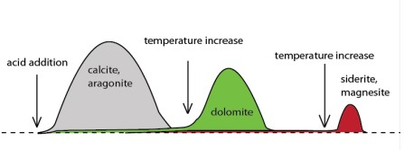

Slide 28
Dolomite content evaluation - continue
The software calculates the strait line equation and the slop + the intersection point can be deduced. For each sediment sample measurement, these are used in order to put the measured result on the line (see results).
The excellent sensitivity achieved by the system is demonstrated in the table next slide by results measured on samples contained more than 0.2% dolomite. These have been prepared carefully by Eyal Wurgaft. The calcite and dolomite ratios in the sample are well known, between 0.1 and 50%.

Slide 29
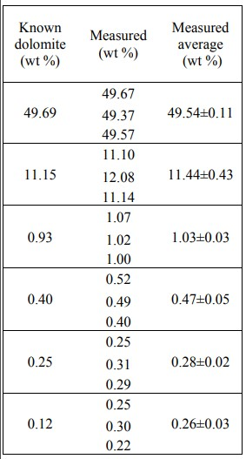
Comparison between known and measured dolomite content experiment

Slide 30
Results
The sample used in this test is SG1, from the continental shelf of the east Mediterranean. Calibration process yielded the following strait line curve,
shown in figure 6. Dolomite unit is ${10}^{−3}$ gram ( = mg). Sediment’s depths start from sea floor and down ( bsfl stands for below sea floor e.g., from the sediment - water interface) , figure 6. The interception point is: 0.70 mg (remnant dolomite as peak area = 0), the slop: 1.38 * ${10}^{−5}$ mg / ppm*sec. The line equation is:
Dolomite = 1.38 * ${10}^{−5}$ x Peak Area + 0.7.
The RSQ, e.g., To what extent variance of the differences between points which can be explained = 0.99. Next slide shows the calibration curve.

Slide 32
Results - continue
The measured Peak Area data values are shown under Peak Area column.
The Dolomite (mg) content is calculated according to the line equation. In the mixed minerals sample measurements, the wt.% is actually [dolomite (mg) / Sample Weight (mg)]*100, in order to get the percentage value. For each of the samples measured data, the dolomite (mg) was calculated using the Dolomite (mg) equation. The dolomite (mg) vs. depth and the Mg concentration in milli molar (e.g., milli mol/litter, denoted mM) vs. depth (cm bsfl) are shown next slide.

Slide 33
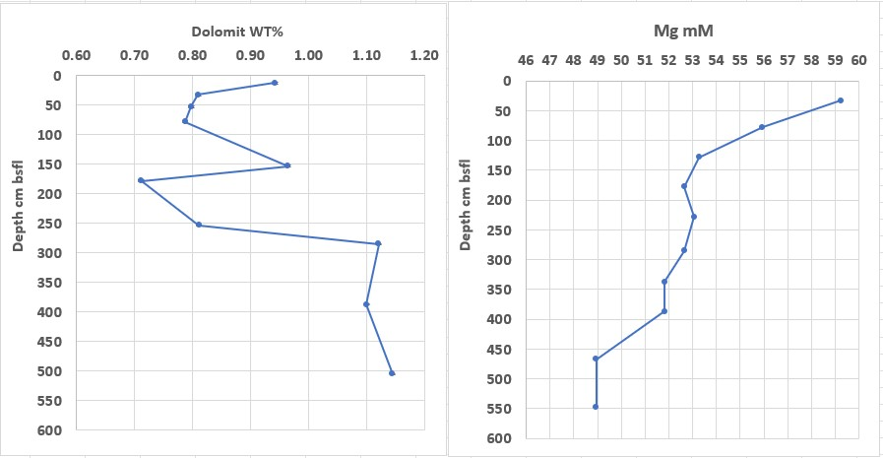

Slide 34
Discussion
The range to consider in Dolomit wt%, is between depths 178 – 285 cm. In this range, dolomite content increases. This range is attributed to the depths 33 – 128 cm in the Mg mM part at the figure, represents Mg concentration range (in mM) decrease. This gap between Mg decrease – dolomite increase, may express a time lag between chemical processes, in which magnesium first precipitated into calcite then in second stage, dolomitization process converted this rich-magnesium calcite to dolomite.
The wide area of dolomite increasing value mentioned above seems consistent with the Mg concentration decrease. The Mg sinks into the sediment in a diffusion process.

Slide 35
Discussion - continue
In order to understand if there is a direct and simple connection between these two outcomes e.g., Mg concentration decrease while dolomite content increase, let’s estimate the Mg loss content in the relevant depths which could be contribute to dolomite creation. The Mg flux, $F_{Mg }$, into the sediment based on the Fick’s first law of diffusion:
$F_{Mg }$= $K_{Mg}$ $\frac{∂Mg}{∂z}$ , where $K_{Mg}$ is the tortuosity-corrected diffusion of ${Mg}^{2+}$(Boudreau, 1997; Schulz, 2006) in ( $m^{2}$* ${yr}^{−1}$) and $\frac{∂Mg}{∂z}$ is the vertical gradient of ${Mg}^{2+}$ (mol * $m^{−4}$). $K_{Mg}$ is 1.90E-05 $m^{2}$ * ${day}^{−1}$ or 6.94E-03 $m^{2}$ * ${yr}^{−1}$. The derivative term (gradient) in this case is the slop of the depths 33 to 128 cm, equals to - 6.26E-02 mM / cm

Slide 36
Discussion - continue
(the minus indicates the flux direction which is negative while depths increase). This milli molar should be converted to $m^{3}$ (1000 litter in 1 $m^{3})$ and the cm is converted to m. The product of these two terms and after units’ conversion yields: $F_{Mg }$= 4.3E-02 mol* $m^{2}$/yr. My assumption here is that each dolomite molecule contains 1 Mg atom (dolomite formula: CaMg${{(CO}_{3})}_{2}$). If all the magnesium flux is used for dolomite creation, let’s see the content that could be created for then relevant sedimentation depths. Assuming that the sedimentation rate in SG area (although it is somewhat slower) is 10 mm/year = 1 cm, (Bareket et al., 2016) which is a quite rapid rate, then for 33 cm of sediment, only 33 years shall be needed. Similarly, for 78 and 128 cm, 78 and 128 years needed. These time periods yield values of :

Slide 37
Discussion - continue
4.34 * ${10}^{−2}$ * 33 = 1.43 mol * ${ m}^{2}$ @ 33 cm
4.34 * ${10}^{−2}$ * 78 = 3.38 mol * ${ m}^{2}$ @ 78 cm
4.34 * ${10}^{−2}$ * 128 = 5.55 mol * ${ m}^{2}$ @ 128 cm
Since dolomite molar mass is 180.40 gram, these values give 257.97 , 609.75, 1001.22-grams (per ${ m}^{2}$) dolomite respectively.
On the other hand, the dolomite measured contents by the test system in the depths of closely linear change attributed to Mg concentration decrease tells a different story. At depths 178, 253, 285 cm (bsfl) the wt% measured values are 0.71, 0.81, 1.12.

Slide 38
Discussion - continue
The sediment weights are known: 100.53 , 106.71 , 103.58 mg. The mass weights can be easily calculated to be: 0.713 , 0.864 , 1.16 mg respectively, much smaller than the Mg flux estimation. Under these results ,the above Mg flux estimation and dolomite contents measured values show no connection. However , apparently further assumptions are needed as for the sediment bulk values which can lead to a feasible connection. The sedimentation rates at the continental shelf site SG1 may be different than mentioned by Bareket et al., 2016. If they are much slower, the measured and calculated values are much closer.

Slide 39
Discussion - continue
In addition, the assumption that all the Mg flux is used for dolomite creation might be not precise. The recent studies mentioned in the introduction, show that part of the magnesium flux is used for reactions with clay minerals on the oceanic crust. Isotopic data presented there shows that the heavy Mg isotope ²⁶Mg is depleted in sea water and in the dolomite relative to the regular element ²⁴Mg but a significant amount of ²⁶Mg is directed to the interaction with the crust below the sediments, as well as the ²⁴Mg, although its preference is dolomite.

Slide 40
Conclusions
In this study I used a new method for dolomite measurement having a very good sensitivity and precision. The measurement results of a very small dolomite amount in a large background of sediment carbonate minerals proved the method correctness performed by the dedicated system test.
The tendency of Mg concentration decreases with depths presented in the background studies is shown also in our test sample SG1 from east Mediterranean. In accordance, the dolomite content increases.
No clear quantitative connection found between the Mg flux per the sedimentation period calculation and the dolomite content measured in the tested sample. Probably, further processes suggestions and conclusions are needed.

